Slide 1

Getting Started with Git
--everything-is-local

Slide 2
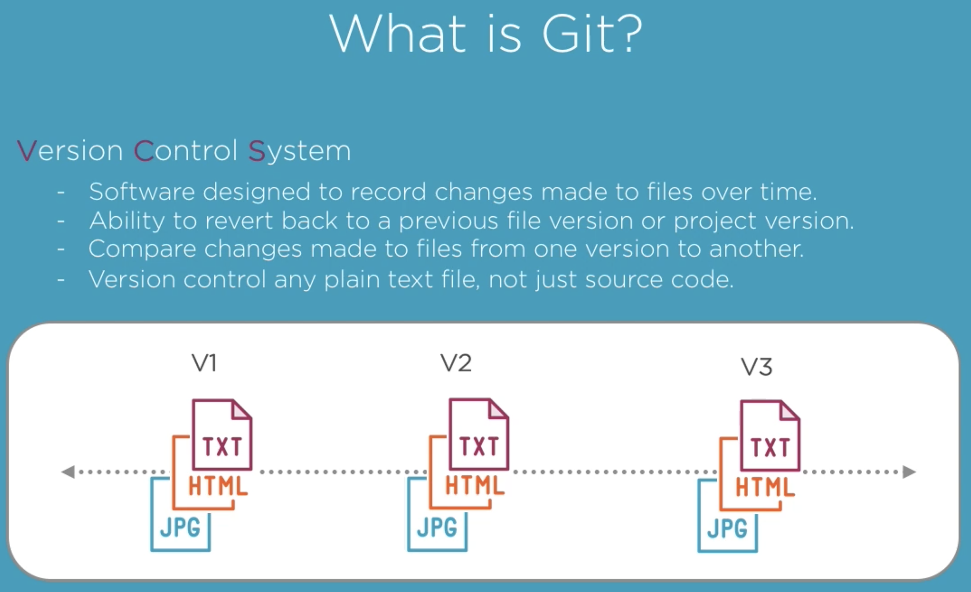
What is Git?
Version Control System
Software designed to record changes made to files over time
Ability to revert back to a previous file version or project version
Compare changes made to files from one version to another
Allows different team members manipulate the same files
Makes easy finding bugs
Notes:
Git is a version control system, also known as a VCS.
A VCS is basically some software designed to record changes made to a file or set of files over time.
This gives you the ability to revert or recall changes to one file or a set of files after you've made them. If you're working on a project that contains a lot of files, version control gives you the ability to control that entire project, and you can revert only one file to its previous version, multiple files to their previous versions, or the entire project back to its previous version.
You can compare changes made to files from one version to another, and you can see exactly what was changed in each file when the change was introduced or who introduced the change. You can even see why a certain change was made.
The great thing about a VCS is that you can version control nearly any type of file on a computer, not just source code files. Students often use version control to keep track of different versions of an essay or a research paper. A designer can use version control to keep versions of an image without worrying about modifying the only version of that one image.
And version control gives you the ability to explore new ideas with your project with the assurance that you can always revert back to a previous version no matter how far you've altered the content.
If you haven't noticed by now, version control is a pretty powerful tool that gives you complete dominance over the life of your project.
And if you think about it, version control is the ultimate time travel machine for your project, and you're in control.

Slide 3
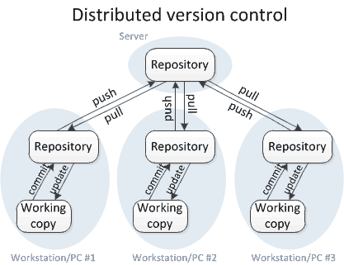
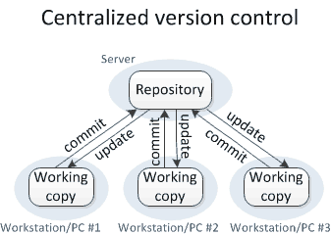
Types of VCS
CVS , Subversion (SVN)
Mercurial,Git
Notes:
Los SCV centralizados como CVS y Subversion (SVN) son sistemas cliente-servidor donde hay un repositorio canónico en el servidor que contiene toda la información de los cambios mientras que los clientes solo tienen copias de trabajo.
En sistemas distribuidos como Mercurial y Git no existe el concepto de repositorio canónico por lo que cada cliente ha de tener una copia completa del repositorio. Desde 2010, la tendencia es utilizar cada vez más SCV distribuidos, en particular Git

Slide 4
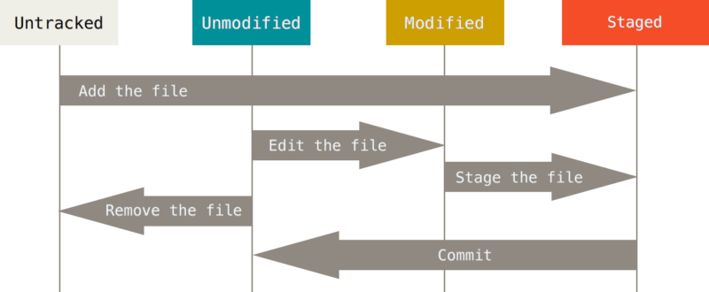
The Stages of a File
Notes:
Git has four main stages a file can occupy, committed (unmodified), modified, untracked and staged.
A file that resides in the committed (unmodified), stage means that the data in this file is safely stored in the repository (local database).
When we make changes to a file, the status of the file moves from committed, or unmodified, to modified.
This modified state means that the file has been altered from the last committed version that is stored in the repository (local database).
Basically, this state just means that we have introduced new changes to the file but haven't committed them yet.
You can think of this state as a work in progress where more changes can be made to that file.
Now, when we have finished the changes, we want to make to a file, the file then moves to the staged state.
This means that we want to take the changes made to that file during the modified state and then commit them to the repository (local database)
to be in his next commit snapshot.
Now, it's important to note that these three stages are applied to files in his project that are being tracked by Git.
In other words, these stages only apply to files that were in the project's last commit snapshot.
A file can also be untracked.
Untracked files are any files added to the project since the last snapshot that Git hasn't been tracking.
To start tracking an untracked file, we can simply add it to his Git project,
and then Git places that file in the staged state, and it will be added into the next commit snapshot.

Slide 5

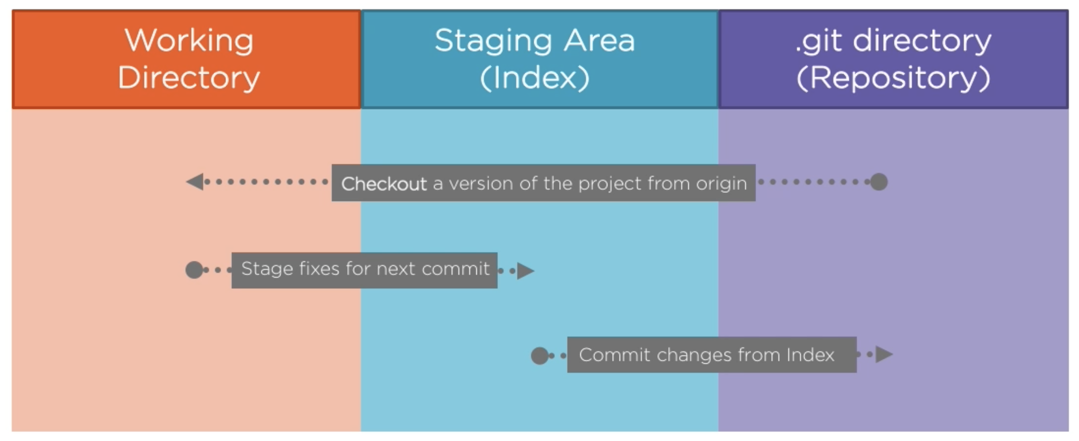
The areas of a Git Project
Notes:
Similar to how a file can reside in three different states, A Git project is made up of three main parts.
We start with the .git directory, also known as a repository. This is the origin of project's data and is what is pulled down from the remote server, and currently being stored on his local computer. This is where Git stores the metadata and object database for his project.
Next, we have the working directory. This is a single copy, also known as a checkout of one version of the project. These files are pulled from local compressed database in the .git directory and placed in the working directory that he can then modify.
The staging area is also known as the index. This is an area that sits between his working directory and the .git directory. We can use the staging area to build up a change or a set of changes that he wants to commit by taking a snapshot of his project with those changes in place, and when he creates a commit, what is committed is only what is currently in the staging area, not what is in his working directory. This gives us the freedom to modify several files, but only commit the changes of a file or files that he wants to.
The uncommitted changes remain in his working directory until we decides to commit them or stash them away for future use.
After we commit the changes, we then push the commits up to the .git directory to update the origin data of the project.
So, in short, if a file version is in the .git directory, it's committed and recorded in that project's repository; if a file is modified and has been added to the staging area, it's staged; and if a file was modified since the last checkout of that file from the .git directory, but has not been added to the staging area, it's modified.

Slide 6
The Two Questions…
for understand any git command
How does this command move information across the Four Areas?
How does this command change the Repository?

Slide 7
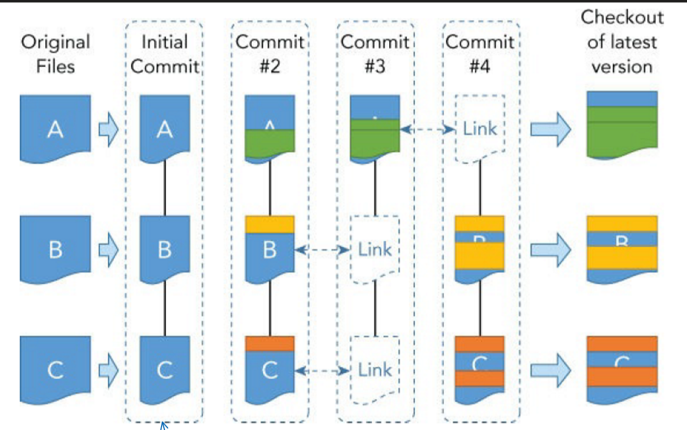
Commits
Notes:
Para registrar información sobre los cambios en el repositorio se utilizan commits
Contenido de un commit:
- el changeset (i.e. los cambios) de cada uno de los ficheros afectados
- punteros a todos los ficheros que no han cambiado
Son instantáneas del estado de los ficheros de un proyecto en un momento dado que pueden volver a restaurarse en cualquier otro momento
Un commit es el único método de introducir cambios en un repositorio.
Los commits generalmente son generados de forma explícita por el usuario pero también pueden ser generados por Git, como sucede en el caso del merge.
Un commit se hace visible con el comando git show

Slide 8
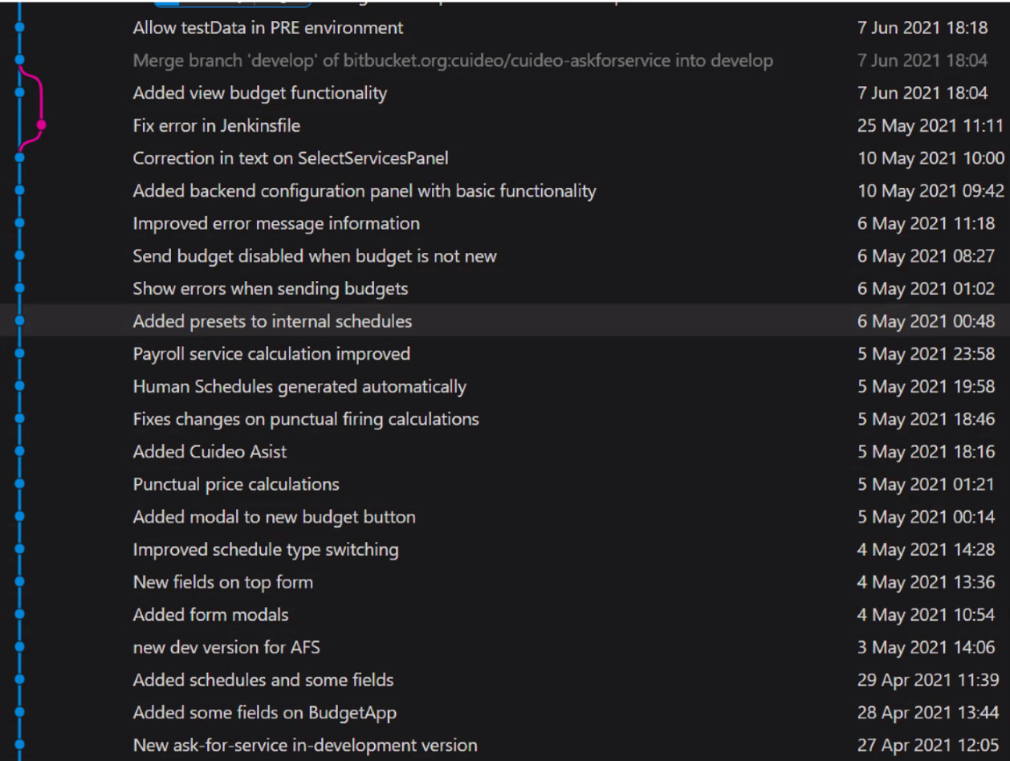
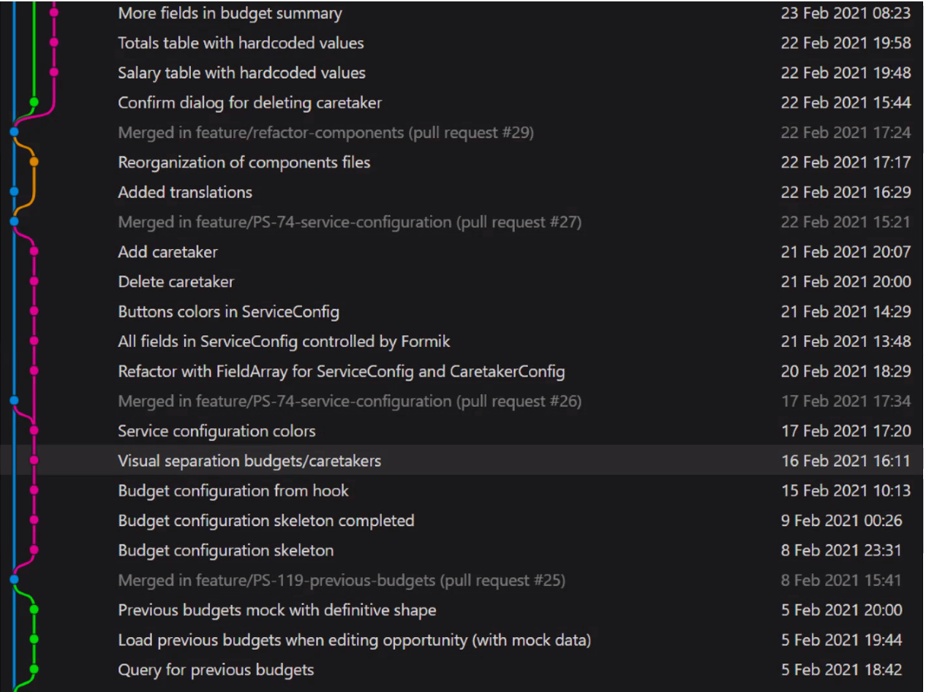
Logs: history of commits
Notes:
Logs: sucesión de commits
Logs en consola v. gráfico
Consenso y tipos de uso: rebase v. Merge
Importancia del texto de los commits

Slide 9
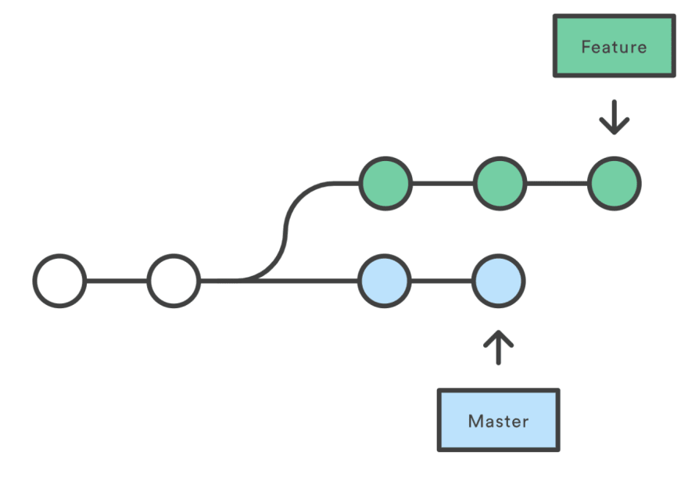
Branches
http://git-school.github.io/visualizing-git/
HEAD
Notes:
Los commits se organizan en secuencias temporales que soportan todo un desarrollo, conocidas como ramas (branch)
Los nuevos commits se añaden al final de la rama de desarrollo que esta activa.
La rama de desarrollo principal, habitualmente denominada master, se crea automáticamente al crear el primer commit
Git internamente se basa en punteros
Cada rama corresponde internamente a un puntero que la define
Rama activa, en la que estoy posicionado, siempre única. Por defecto la rama master
HEAD -> puntero al último commit de la rama activa. Si se cambia la rama activa, HEAD se actualiza automáticamente

Slide 10
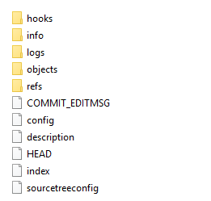
HEAD
bash-shell
$ cd .git
$ cat HEAD -> ref: refs/heads/master
$ git checkout –b newFeature
$ cat HEAD -> ref: refs/heads/newFeature
Windows
cd .git
type HEAD -> ref: refs/heads/master
git checkout –b newFeature
type HEAD -> ref: refs/heads/newFeature
.git
Notes:
Cuando se añade un commit, HEAD cambia para seguir apuntando al último commit de la rama activa
Cuando se cambia a una rama diferente, HEAD cambia para seguir apuntando al último commit de la nueva rama.
Desde el S.O es posible comprobar como de produce este desplazamiento de punteros

Slide 11
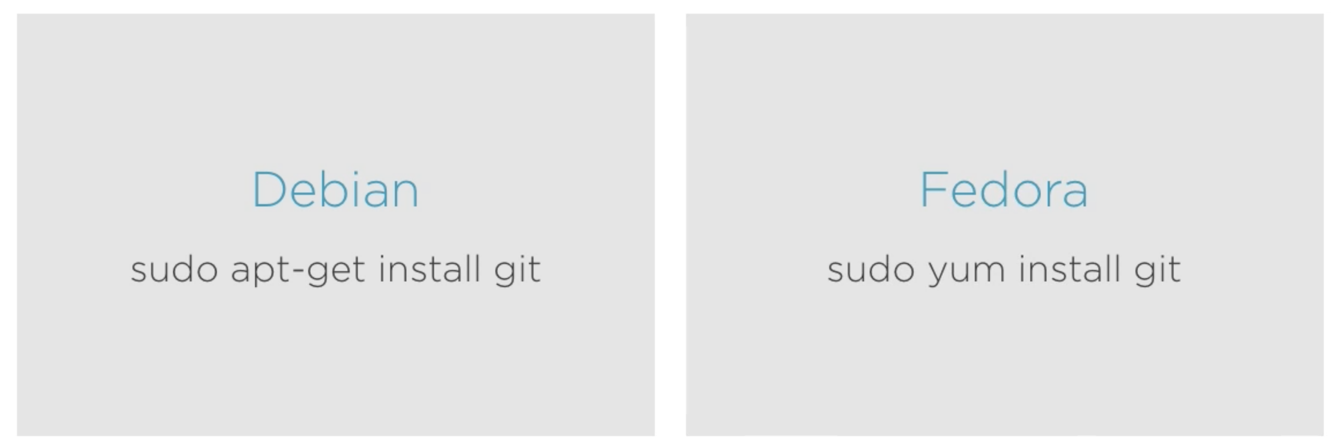
Install Git on Linux

Slide 12

Install Git on Windows

Slide 13
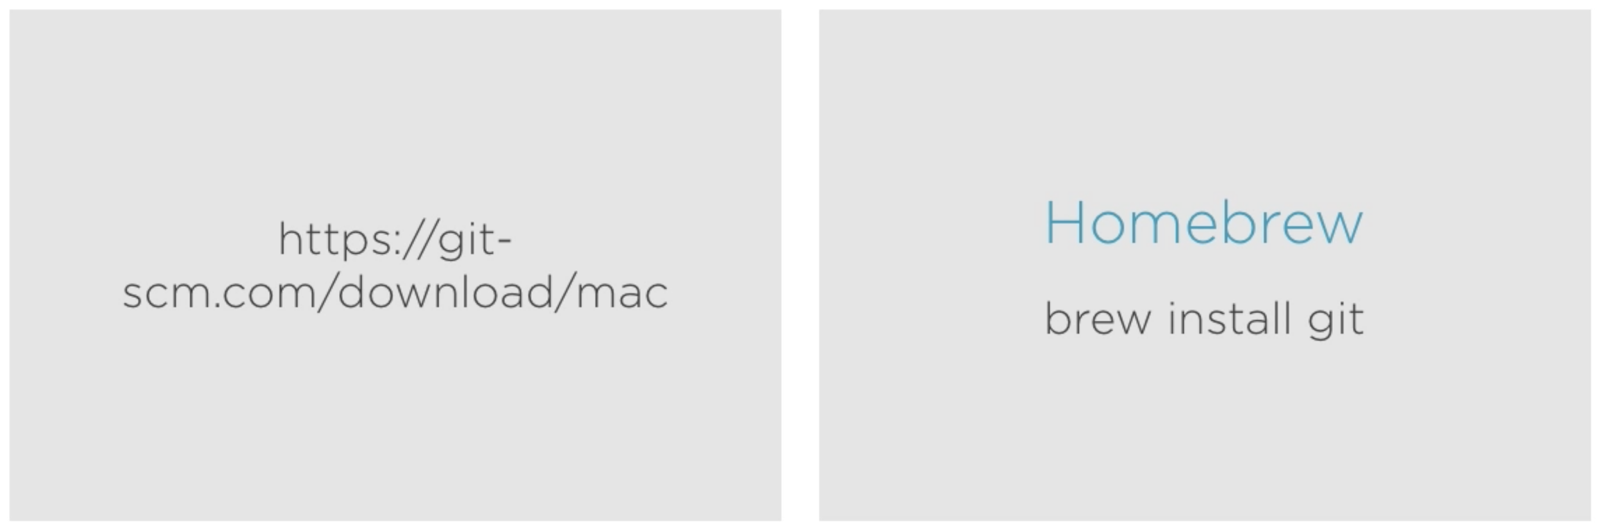
Install Git on Mac

Slide 14
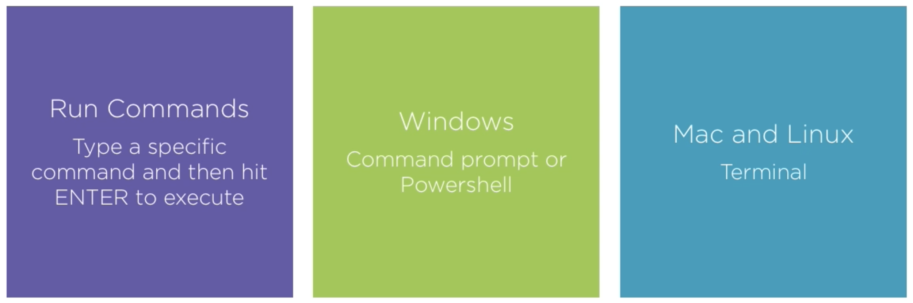
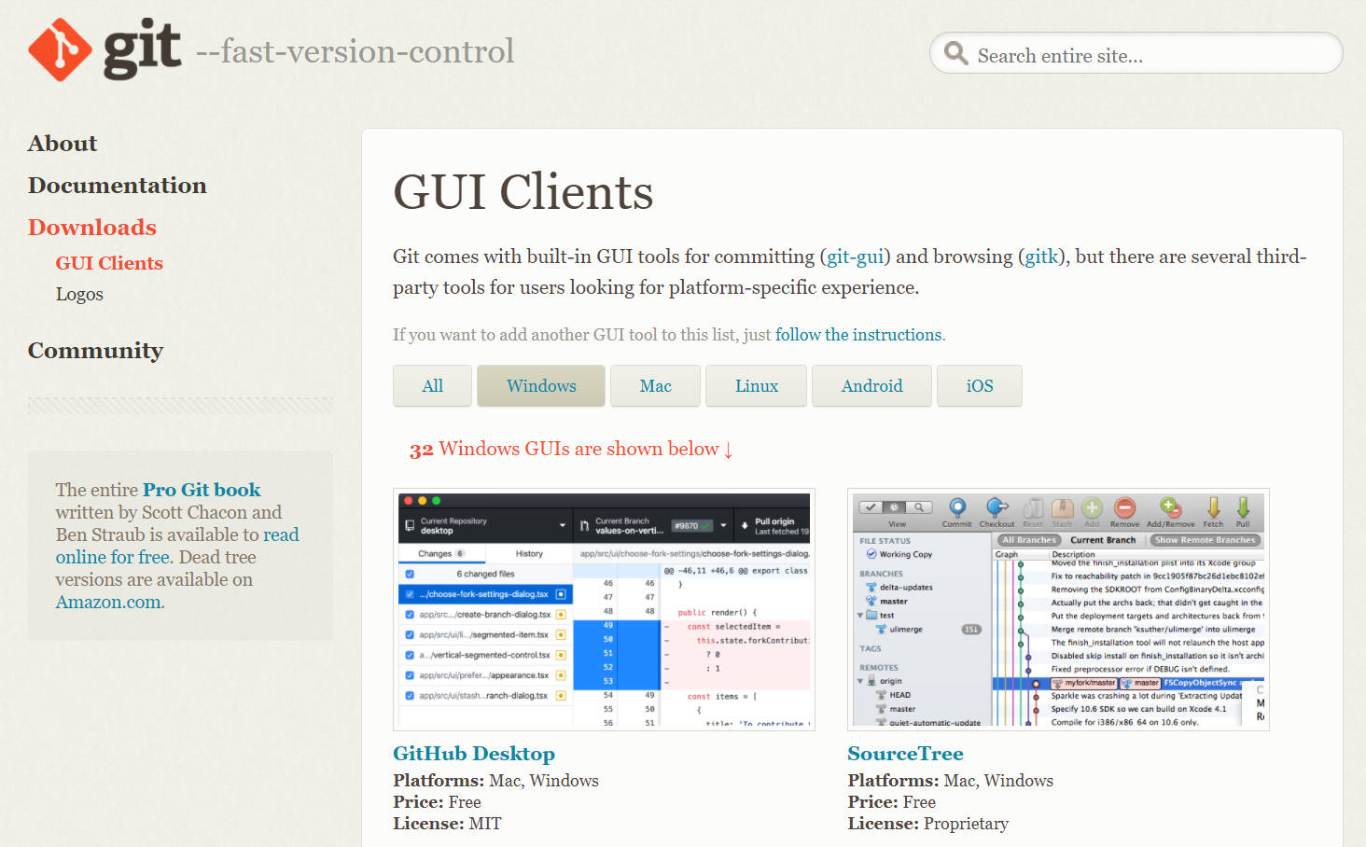
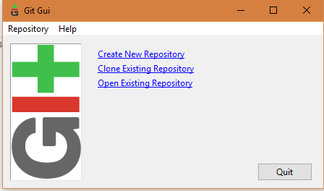
Command Line (CLI) v Graphic Interfaces
https://git-scm.com/download/gui/windows
Notes:
The command line is used for…
For Windows users you can open the …
For Mac and Linux you have a preinstalled terminar that you can open.

Slide 15
Using the Command Line
pwd Print working directory
cd Change working directory ( cd .. or cd ~ )
ls / dir List files in a directory ( dir for windows users )
mkdir Create a new empty folder
Notes:
There are some slight differences with these commands depending on what system you're using, but the result will be the same.
The first command to know is the pwd command. Pwd, which stands for print working directory, just returns your current folder path location. This is a simple, yet useful command that simply lets you know where you are at currently inside terminal.
Now that we know where we are, you can use another command to change your location. The cd command, which stands for change directory, will move us into another directory. To go one directory upwards in the current folder path, we can type cd dot dot. You can also cd into a subfolder by typing cd and then the name of the subfolder. If you want to jump to the beginning home folder, you can type cd tilde. Now, there are several other options on how to use the cd command, but for this course, we will mostly be using the cd .. command to go up one directory.
Another useful command is how to list the files in the directory. For Linux and Mac users, we type ls, and for Windows users, you can type dir.
To create a new empty file, we can use the command touch for Mac and Linux users and the command copy con for Windows users
you can create a new empty folder by using the mkdir command.
As mentioned, these are just a few simple commands that you can use in the command line.
Now there are many, many other commands and even other options to use with these few commands that we just learned,
but for now, we'll stick to just these few commands.

Slide 16
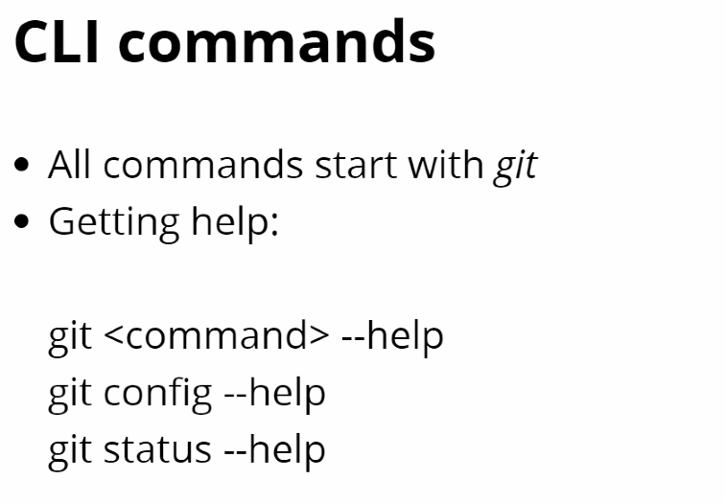
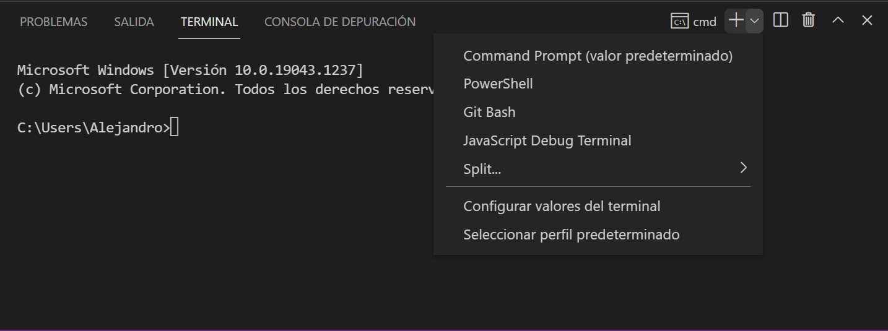
Command Line (CLI)
CLI gives us more control than GUI
CLI en VSC
bash / gig bash
Autocomplete with tab
git --version

Slide 17
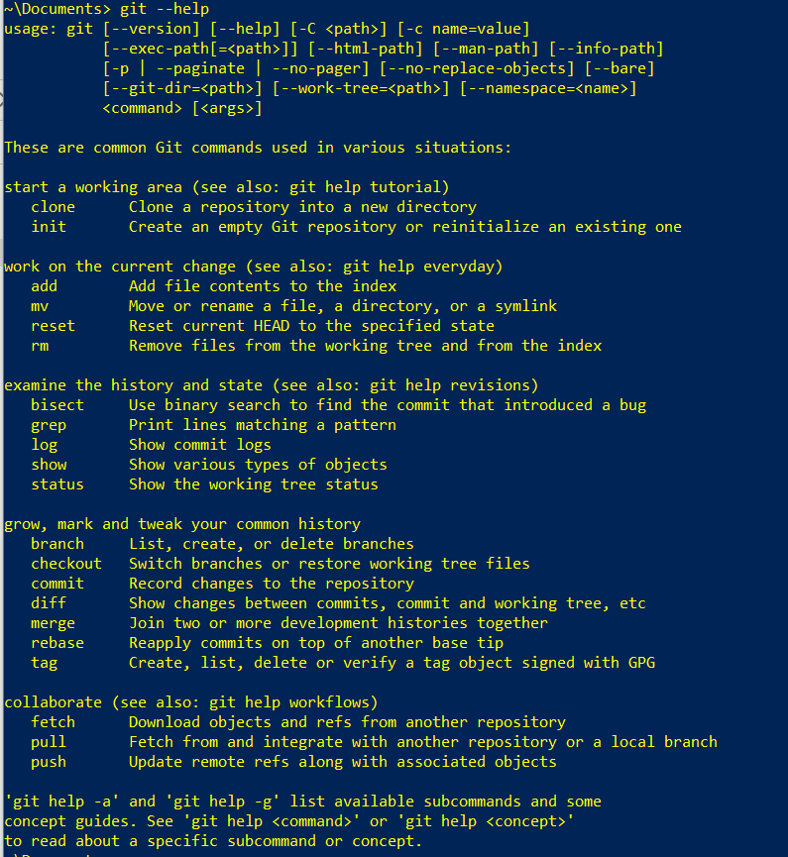
Git Help
man git
git help config
git help

Slide 18
Git Config
Git configuration
Configuration variables
System (O.S.): git config --system
Global (O.S. user): git config —global
Local (project): git config [--local]
git config
git config --global user.name “Alejandro Cerezo”
git config --global user.email “alce65@hotmail.es”
git config –list [--show-origin]

Slide 19
Extra Configuration
- Si no habéis instalado Git diciéndole que VSCode sea su editor por defecto, para configurarlo hay que lanzar este comando:
Mac: git config --global core.editor “code --wait” ·
Windows: git config --global core.editor "<ruta del VSCode>\Code.exe" --wait
Otras configuraciones de Git:
git config --global core.autocrlf false <- controlado desde el .editorconfig
git config --global core.ignorecase true <- si estáis en WindowsA

Slide 20

Install Git
Configure Git
Initialize a new Git project
Use git

Slide 21
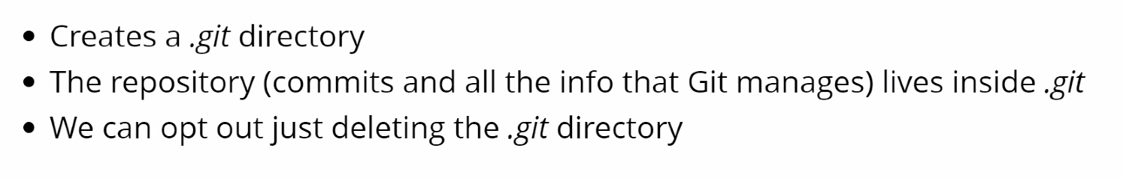
Initialize a New Git Repository
git init // Create an empty Git repository or reinitialize an existing one
cd .git // Enter Git configuration folder
ls // List all the files in the current folder
cd .. // Move to the parent folder
Files: .gitignore - README.md
Notes:
Git init Transforma un directorio en un directorio de trabajo Git
Añadiendo el repositorio de commits al directorio, lo que lo convierte en un directorio de trabajo Git
Lo añade en el subdirectorio oculto .git que contiene la base de datos donde guardar los commits
La mayoría de los comandos Git se invocan en el directorio de trabajo o un subdirectorio

Slide 22
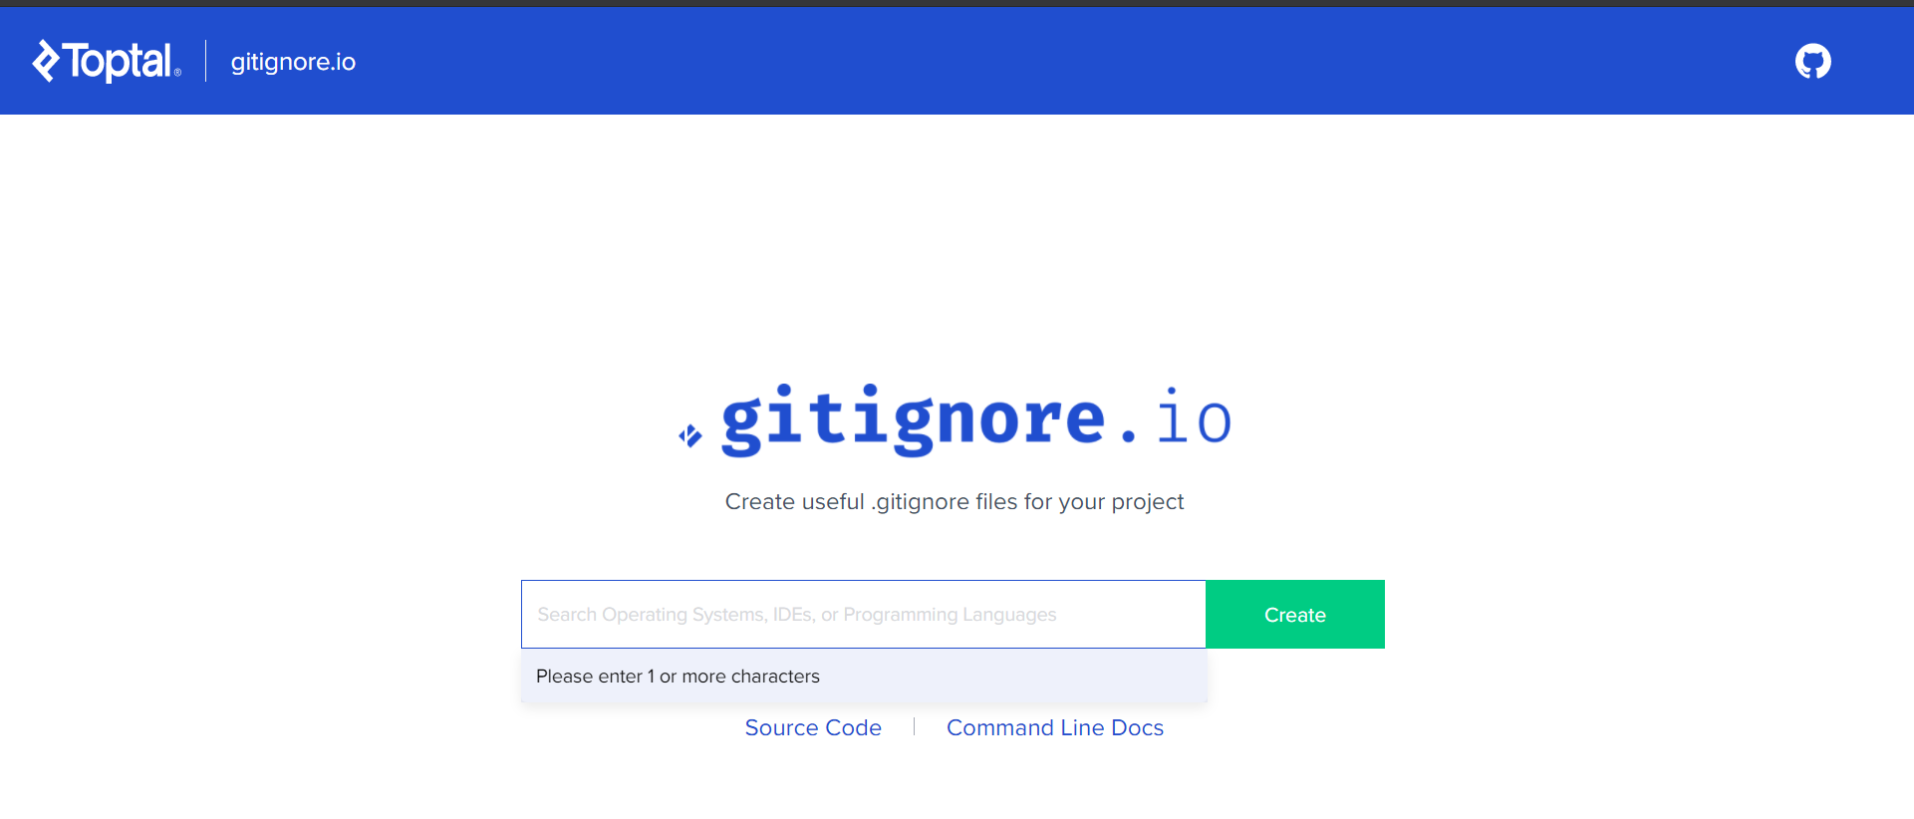
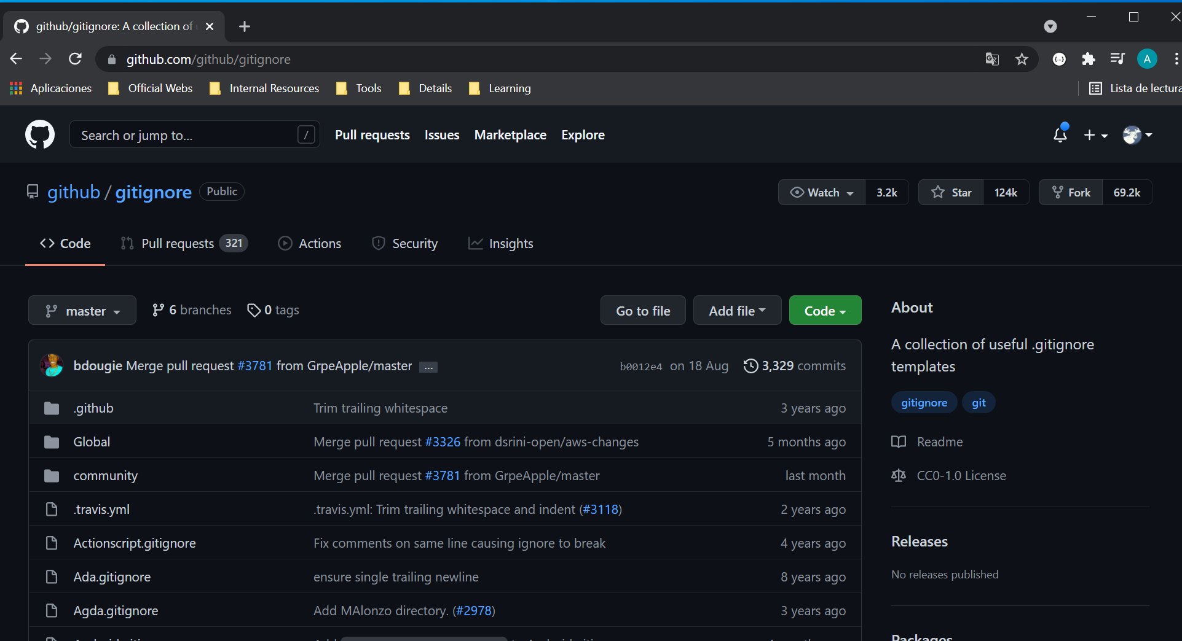
.gitignore
https://git-scm.com/docs/gitignore
https://www.atlassian.com/git/tutorials/saving-changes/gitignore

Slide 23
Files Tracked By Git
Committed Unmodified changes from the last commit snapshot
Modified Changes made to files since last commit snapshot
Staged Changes marked to be added into the next commit snapshot

Slide 24
git add / commit: Track a New File
touch lessons.txt
git status
git add lessons.txt
git status
git commit´- m “Add Lessons File”
git add
git commit
git status

Slide 25
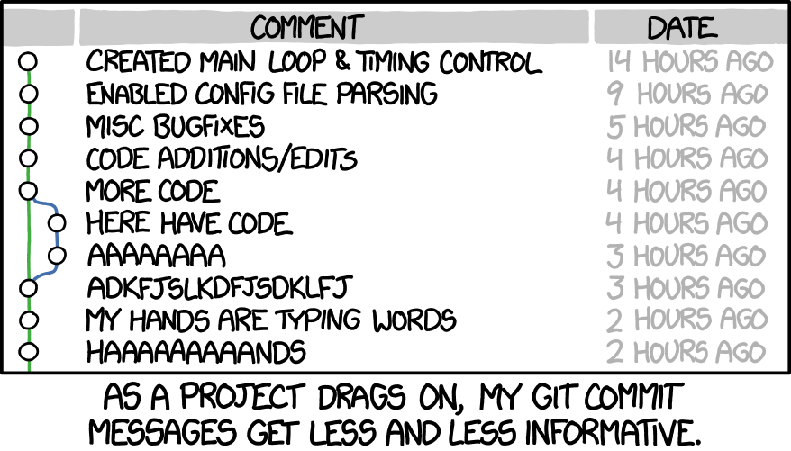
Commit Messages
Important things to remember:
The message should describe the changes in a commit
Avoid generic messages like "Changes", "New file", "Fixes", "CSS", "Merge"...
Don't write too long messages (50 chars)
Isolate single features or fixes in each commit (what not to do)
https://chris.beams.io/posts/git-commit/

Slide 26
Rules of a great Git commit message
Separate subject from body with a blank line
Limit the subject line to 50 characters
Capitalize the subject line
Do not end the subject line with a period
Use the imperative mood in the subject line
Wrap the body at 72 characters
Use the body to explain what and why vs. how

Slide 27
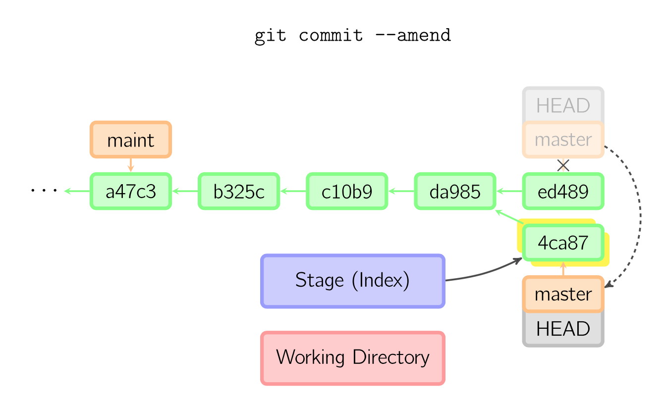
Modify last commit
Last commit desapear / reapear with the added content

Slide 28
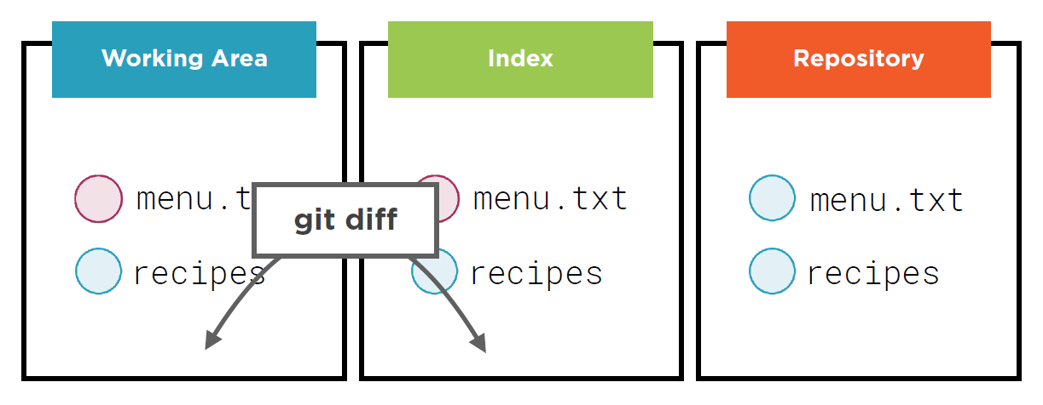
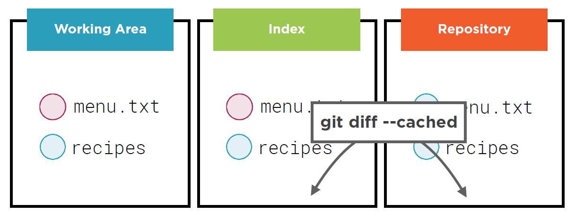
git diff

Slide 29
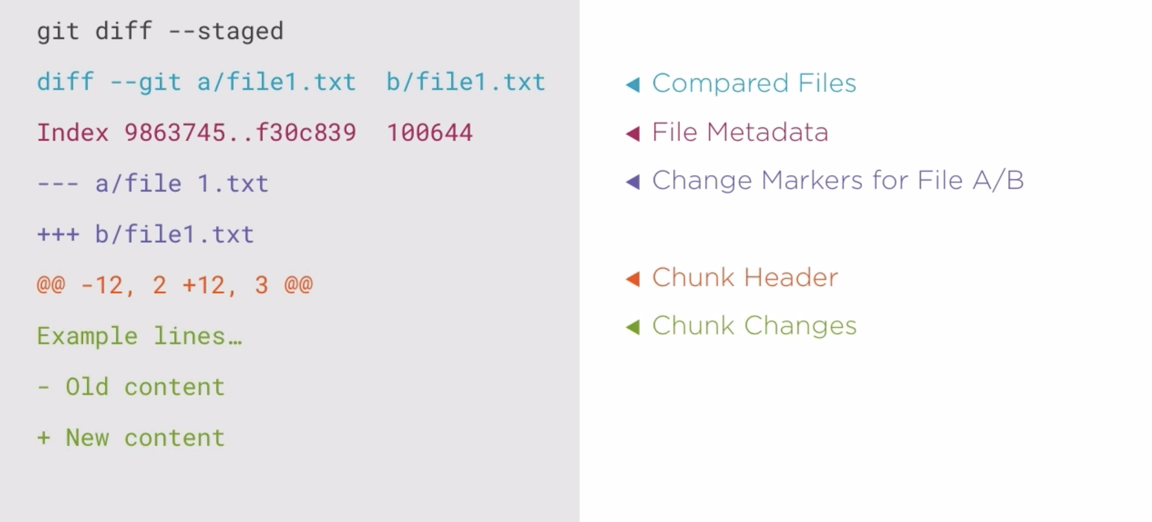
Git Diff Explained

Slide 30
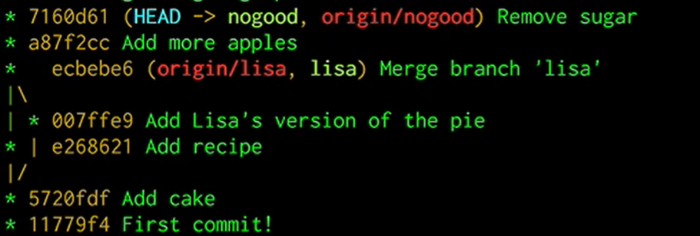
git log: Check Commit History
git log
git log -1
git log --oneline
git log --stat
git log --patch
VSC Git Graph
git log –graph –decorate --oneline

Slide 31
Aliases
alias.<name> <command>
Aliases by CLI
System (O.S.): git config --system alias.co commit
Global (O.S. user): git config —global alias.co commit
Local (project): git config [--local] alias.co commit
Aliases by editing files
/programs/git/gitconfig
$HOME/<urer>]/.gitconfig (specific for the user)
.git//config (specific for the repository)
Use example
git config --global alias.hist “log --pretty=format:"%h %ad | %s%d [%an]" --graph --date=short”

Slide 32
Remove and Move Files
From the O.S.
From git
// Remove file
git rm <...file...>
// Remove from tracked files (unstaged the file.)
git rm --cached <...file...>
git reset HEAD <...file...>
// Rename files
git mv <...file...> <...newFile...>

Slide 33
Time travel: git checkout
In the repository, it moves the HEAD reference => change de repository: changes the current commit
generally, to another branch
to another commit in the branch
It takes data from the new current commit, and it copies that data from the repository
to the working area and
To the index.
Time travel to the past

Slide 34
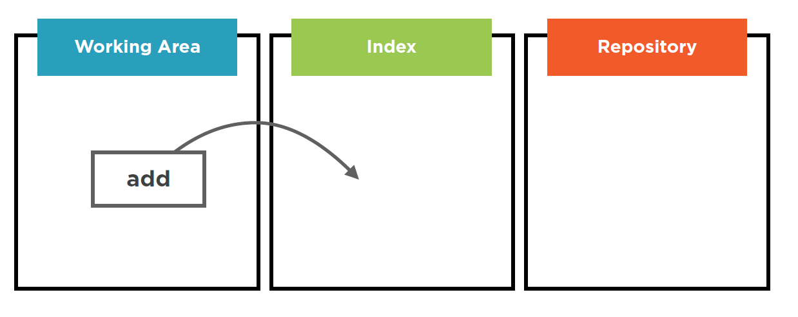
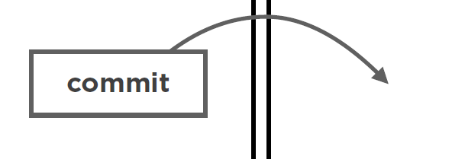
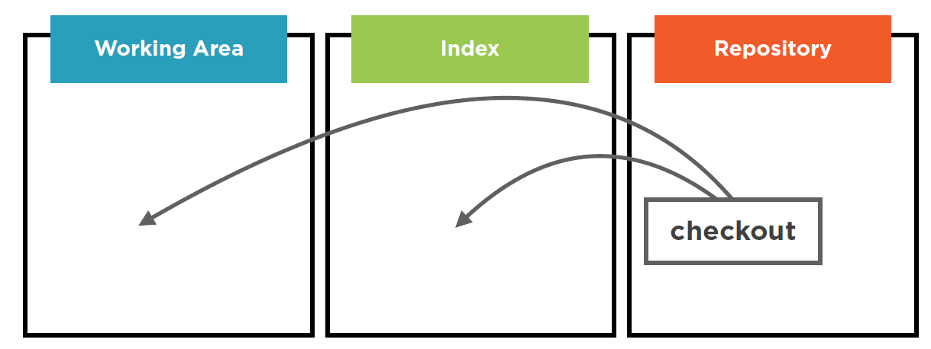
In sumary
New active commit (with HEAD)
Previous commit changes to
active (with HEAD)

Slide 35
git restore & git switch
In the repository, git checkout moves the HEAD reference => change de repository: changes the current commit
generally, to another branch
to another commit in the branch (recovering and earli commit)
git switch
git restore
If we need to unstage some file:
git restore --staged index.html
If we need to undo changes in working directory:
git restore scripts.js
Warning: this operation can't be reverted!
Better functionality for unstage a file, in stead of reset

Slide 36
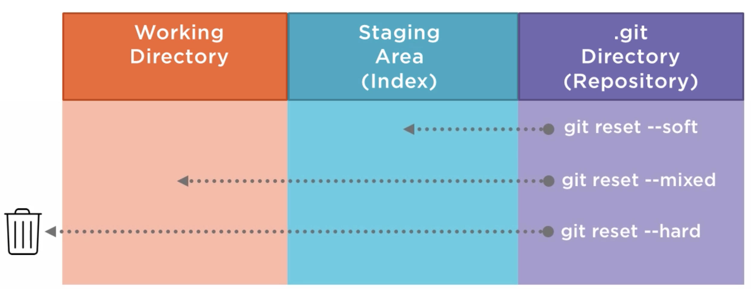
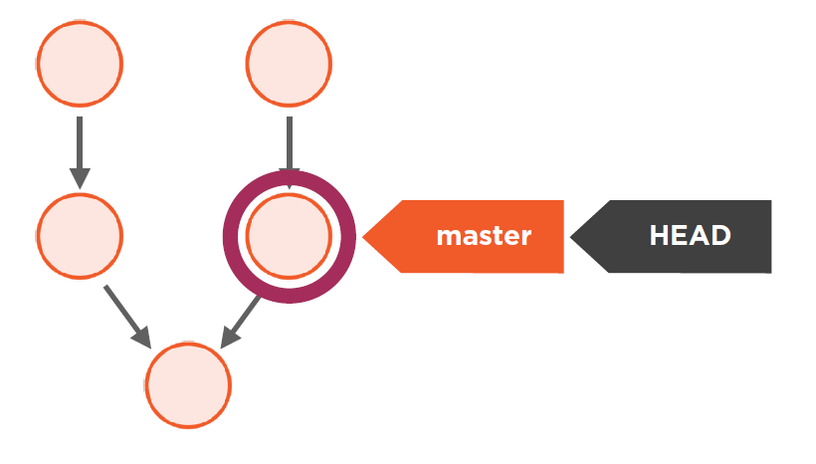
The Three Options of Git Reset
It moves the current branch, so it also changes the current commit.
Optionally, it copies the files and directories from the new current commit to the working area and the index

Slide 37
Squashing
git commit a
git commit b
git commit c
git reset –soft HEAD~3
// a – b – c came back to index
git commit a-b-c

Slide 38
Commits in summary (again)
It's a snapshot of our project
It has an identificator
It has a message describing the changes
It doesn't dissapear (not true)
It knows which its previous commit/s are
It knows who its author is
It knows the date and time when it was created

Slide 39
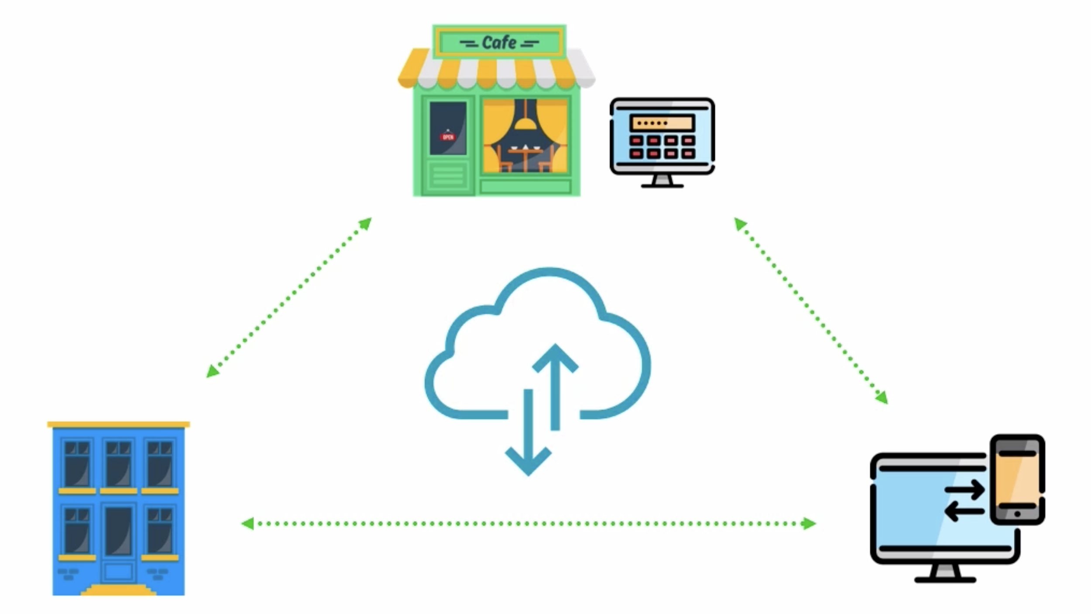
Servers
gitolite http://gitolite.com/gitolite/index.html
gitosis https://git-scm.com/book/es/v1/Git-en-un-servidor-Gitosis
GitLab, para Linux (interfaz Web,)https://about.gitlab.com/equipos
Hosting (repositories)
GitHub - https://github.com/
Bitbucket https://bitbucket.org/
GitLab https://about.gitlab.com/

Slide 40




Repesitories Hosting
Colaboration

Slide 41
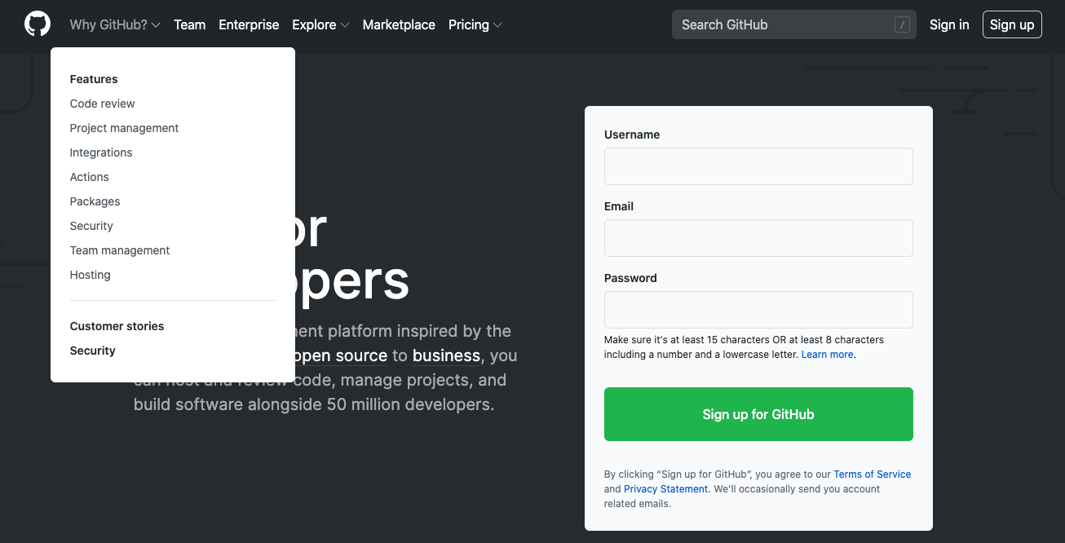

Notes:
Posibilidades del acceso anónimo
Descarga / clonación de proyectos de software libre
Perfil de los programadores (uso social / laboral)
Posibilidades al disponer de cuenta de usuario (gratuita)
Crear repositorios propios
Copiar repositorios de otros (fork)
Importar repositorios a partir de su URL, incluso en otros formatos
Crear una organización para albergar múltiples proyectos relacionados
…

Slide 42
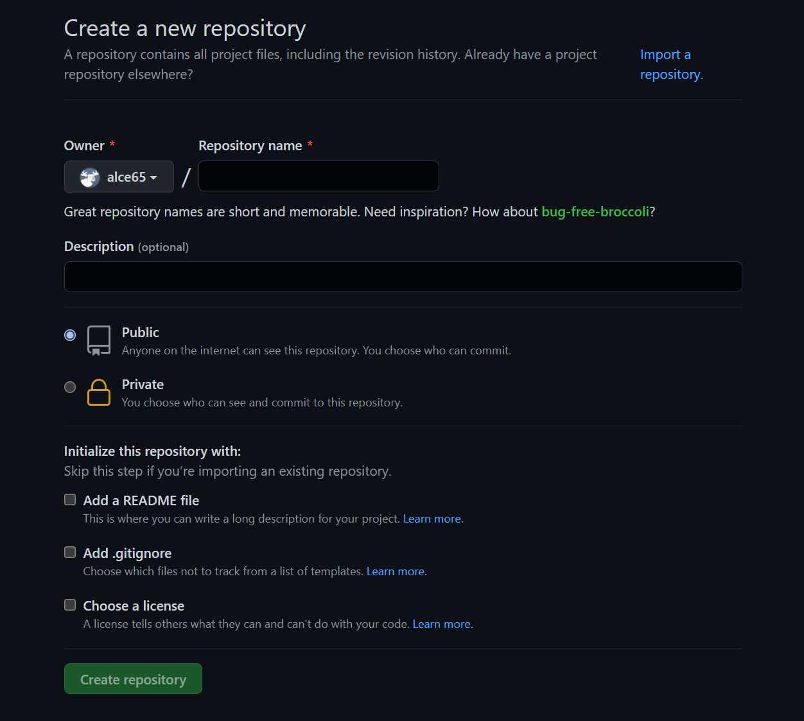
Create a new GitHub repository

Slide 43
Push a Git Repository to a Code Hosting Provider
git remote : connect to remote
git push : update remote
echo “# skylab-bootcamp-202007” >> README.md
git add .
git commit -m “Create readme file”
git remote add origin https://github.com/<...>/<...>.git
git push -u origin master

Slide 44
Code hosting providers: Github
Create an account
Push out Git project to a code hosting provider

Slide 45
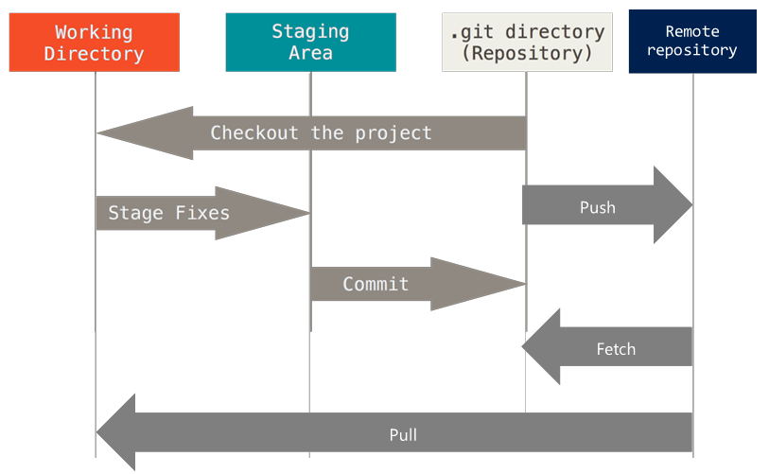
Extended Git Basic Operations

Slide 46
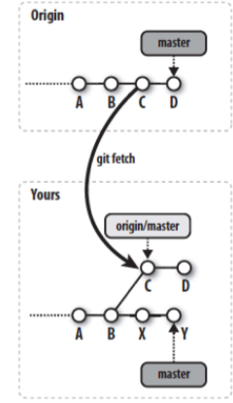
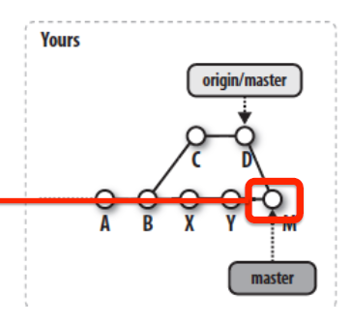
Import data from a GitHub repository
git pull
git fetch
git pull <repo> <branch>
Git Pull = Git Fetch + Git Merge
git pull -rebase <repo> <branch>
git fetch <repo> <branch>

Slide 47
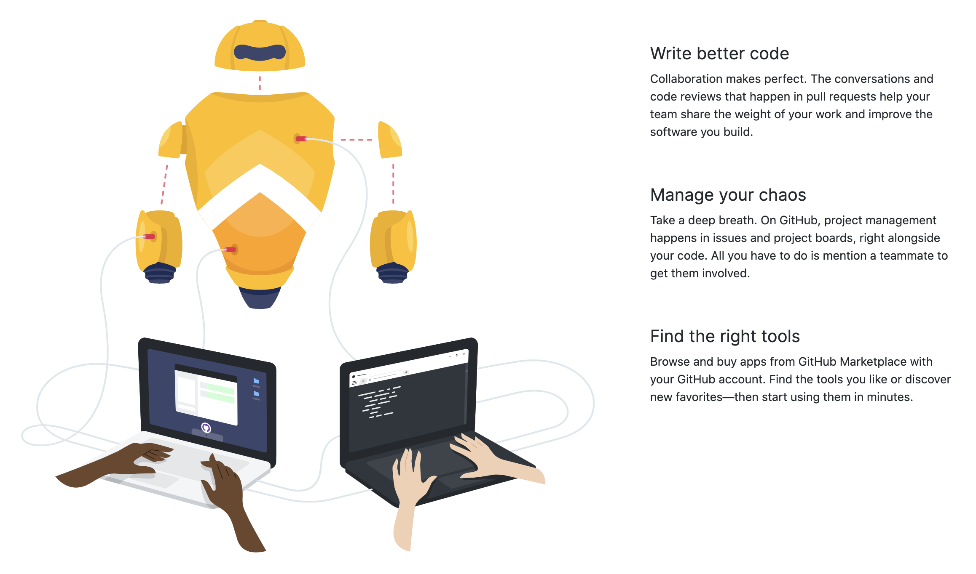

Slide 48
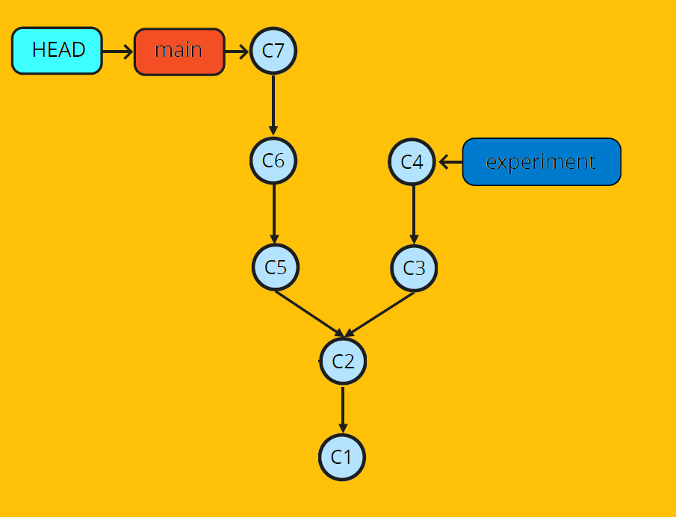
Branches
Branches allow developing in isolated contexts
Branches are just references
A branch points to a commit
A repo has at least one branch
We shouldn't commit to the main branch

Slide 49
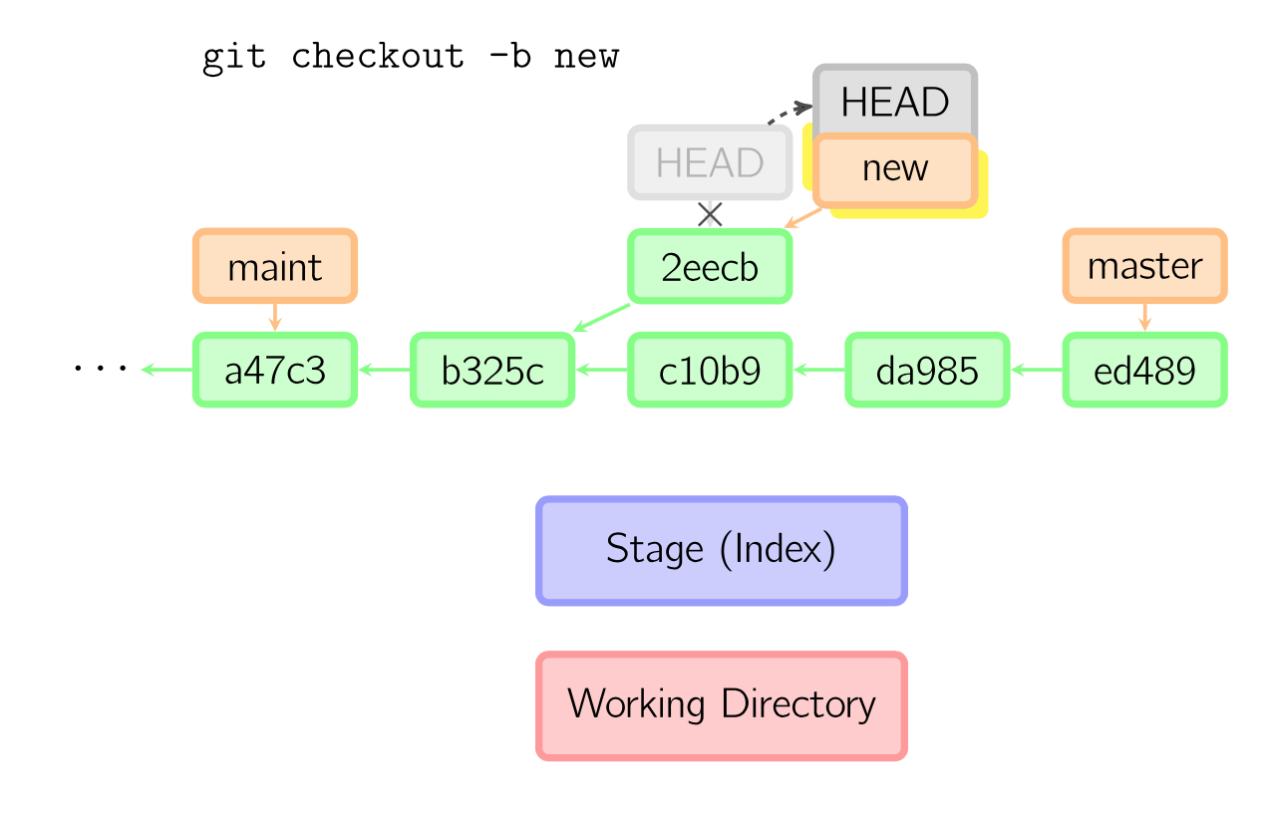
Branches: commands
Create: git branch <branch-name>
Create and move to git checkout -b <branch-name>
Create fron one commit git branch <branch-name> <id-commit>

Slide 50
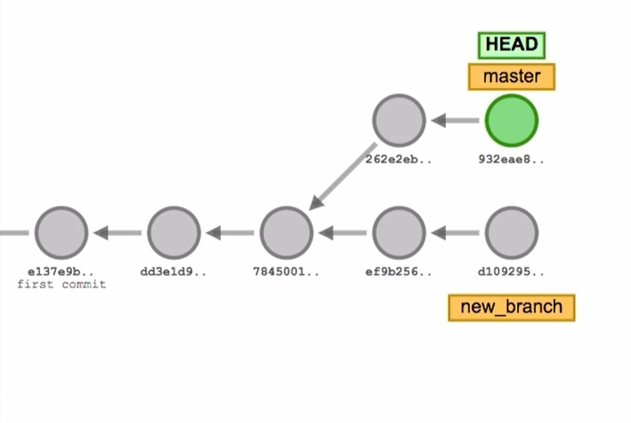
Introduction to Branches
http://git-school.github.io/visualizing-git/
git commit
git commit
git checkout -b new_branch
git commit
git commit
git checkout master
git commit
git commit
git checkout new_branch
git commit

Slide 51
More branch commands
git branch |-> List
git branch –a |-> List with remotes
git show-branch |-> View
git branch –m <branch-old> <branch-new> |-> rename
git branch –d <branch> |-> delete
git branch –D <branch> |-> forced delete
git push <remote> :<branch> |-> remote delete

Slide 52
Working with Branches: stash
git stash / git stash --include-untracked
git stash list
git stash show
git stash apply
git stash clear
git stash pop
Stash (like a clipboard)
- takes all the data from the working area and the index that is not in the current commit in the repository,
- copies all of that data to the stash.
And then it also checks out the current commit (‘clean’ working area and the index )

Slide 53
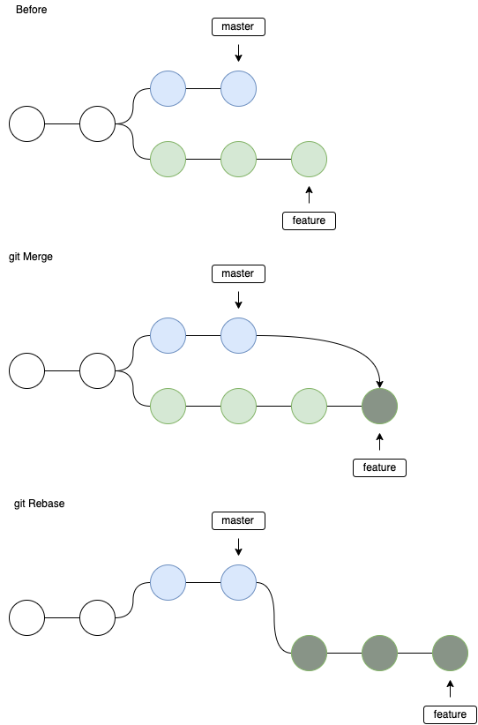
Combining branches
Merge
Fast-forward
Recursive or tree-way (no-ff)
squash
Rebase

Slide 54
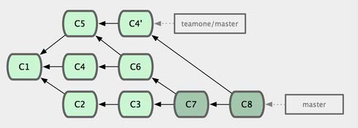
Merge branches
git merge <source_branch> (run it while on the target branch)
Includes in one branch the work from another branch
Goal: we want one branch to have/include commits from another branch
https://medium.com/@mena.meseha/git-merge-vs-rebase-556563b26431

Slide 55
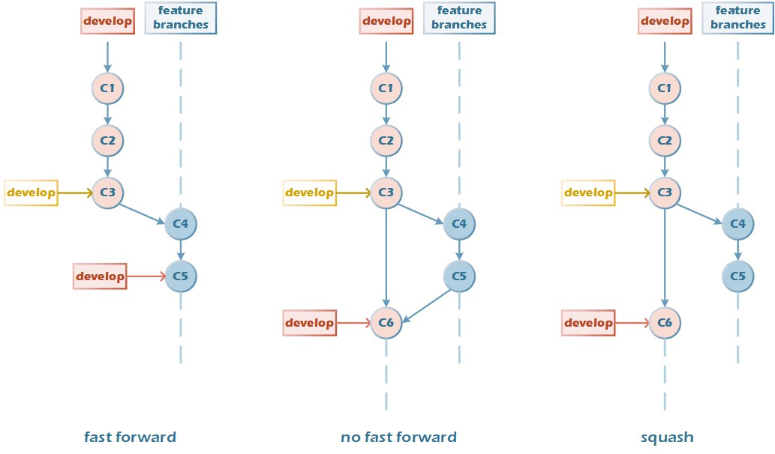
Merge branches - Scenario 1
After the feature branch is cut out, there is no new commit on the develop branch.
no conflicts
doesn't create a new commit
creates a new commit
Notes:
Fast-forward, if there is no disagreement, it will move the file pointer directly. The starting point of the feature branch is not visible.
No-fast-forward( — no-ff), which preserves the integrity of the commit chain.
Squash, compressing unnecessary commits; it’s impossible to see that the feature branch is merged into develop; feature, develop remains relatively independent.

Slide 56
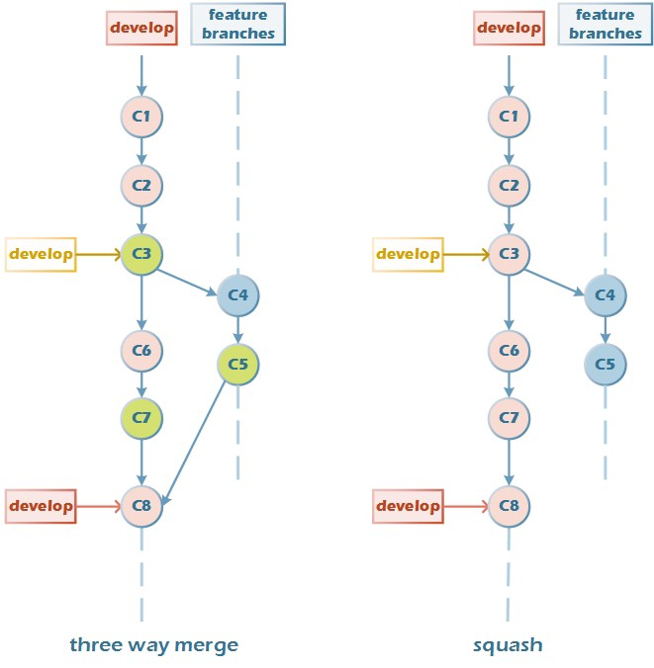
Merge branches - Scenario 2
After cutting out the feature branch, C6 and C7 are submitted on the develop branch.
cannot be fast forward.
creates a new commit, possibility of conflicts

Slide 57
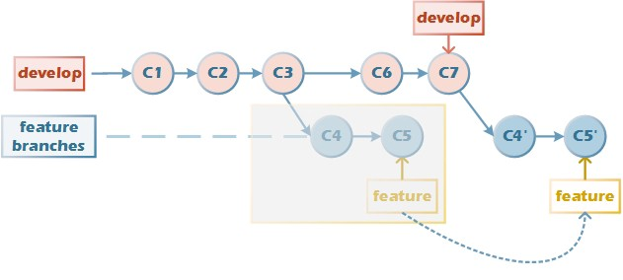
Rebase
Rebase, has no effect on the specified base itself; just rewrite the commit history after the base.
Notes:
Rebase/rebase, from the old base to the new base, on the basis of the new base to reproduce the modification process of another branch, the version tree is like a chain of two chains together to achieve a linear effect.

Slide 58
Git merge conflicts
Managing contributions between multiple distributed authors ( usually developers ).
The git merge command's primary responsibility is to combine separate branches and resolve any conflicting edits.
Most of the time, Git will figure out how to automatically integrate new changes.
A merge will fail to start when Git sees there are changes in either the working directory or staging area of the current project.
Sometimes multiple developers may try to edit the same content: Developer A tries to edit code that Developer B is editing . In the merge, Git cannot automatically determine what is correct and a conflict may occur..

Slide 59
Resolving conflicts
$ git merge new_branch_to_merge_later
Auto-merging merge.txt
CONFLICT (content): Merge conflict in merge.txt
Automatic merge failed; fix conflicts and then commit the result.
$ cat merge.txt
<<<<<<< HEAD
this is some content to mess with
content to append
=======
totally different content to merge later
>>>>>>> new_branch_to_merge_later
git status
git diff

Slide 60
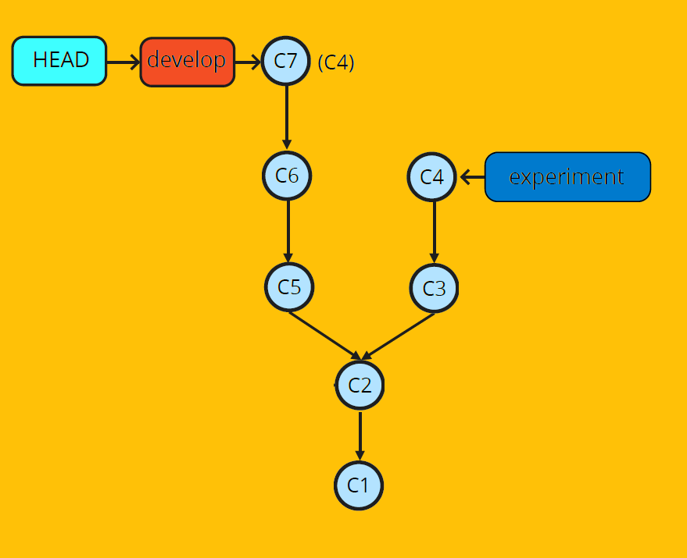
Cherry-picking
Command to cherry-pick a commit: git cherry-pick <commit> -x
Apply a single commit to a branch
It doesn't apply previous commits
Modifier -x adds "Cherry-picked from XXXX" to the commit message
Conflicts: git status

Slide 61
Changes in the history
git commit --amend
git rebase -i
git reflog
git filter-repo
git revert
The Golden Rule:
never change shared history.

Slide 62
Distributed Workflow
Distribution Model
How many repositories
do you have? Who can
access them? …
Branching Model
Which branches do you
have? How do you use
them? …
Constraints
Do you merge or do you
rebase? Can you push
unstable code? …

Slide 63
Distribution Model
Peer to Peer Model
Centralized Model
Pull Request Model
Dictator and Lieutenants Model
Many projects use a mixed
Distribution Model.

Slide 64
Branching Models
Stable and unstable branches
Common Branches
Integration Branch
Release Branch
Feature Branch
Hotfix Branch

Slide 65
A Few Examples of Constraints
rebase, don’t merge / merge, don’t rebase
Only developer X can do Y on branch Z
Don’t push to a red build
Squash a feature to a single commit before you merge it to master

Slide 66


